Slide 1

Application Insights

Slide 2

About

Slide 3
AGENDA
Azure Application Insights
Azure Portal
Visual Studio
Visual Studio Code
Questions
Application Performance Management (APM)

Slide 4
Application Performance Management (APM)
Application Performance Monitoring
Traces
Metrics
End user Experience
Errors
Performance
Notes:
APM is "the translation of IT metrics into business meaning ([i.e.] value).

Slide 5
Application Performance Management (APM)
Performance of web requests
Code level performance profiling
Usage and performance of all application dependencies like databases, web services, caching
Detailed traces of individual web requests or transactions
Notes:
APM is "the translation of IT metrics into business meaning ([i.e.] value).

Slide 6
Application Performance Management (APM)
Basic server metrics like CPU, memory
Application framework performance counters
Custom applications metrics created by the dev team or business
Application log data and errors
Real user monitoring (RUM)
Notes:
APM is "the translation of IT metrics into business meaning ([i.e.] value).

Slide 7


Slide 8
Azure Application Insights
Extensible Application Performance Management (APM) Service
Monitor live applications
Automatically detect performance anomalies
Powerful analytics tools
Continuous improvement
Multiple platforms
Integrates into DevOps process and tools
Integrates with AppCenter and HockeyApp
Notes:
Request rates, response times, and failure rates - Find out which pages are most popular, at what times of day, and where your users are. See which pages perform best.
Dependency rates, response times, and failure rates - Find out whether external services are slowing you down.
Exceptions - Aggregated statistics, specific instances. Server and browser exceptions are reported.
Page views and load performance - reported by your users' browsers.
AJAX calls from web pages - rates, response times, and failure rates.

Slide 9
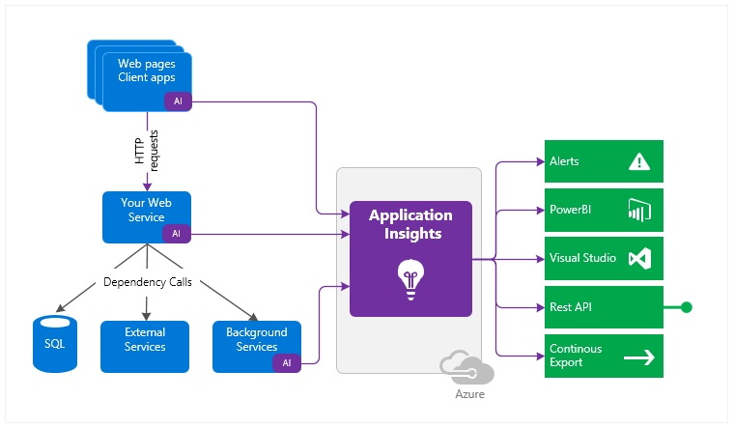
Azure Application Insights
Notes:
Request rates, response times, and failure rates - Find out which pages are most popular, at what times of day, and where your users are. See which pages perform best.
Dependency rates, response times, and failure rates - Find out whether external services are slowing you down.
Exceptions - Aggregated statistics, specific instances. Server and browser exceptions are reported.
Page views and load performance - reported by your users' browsers.
AJAX calls from web pages - rates, response times, and failure rates.

Slide 10
Azure Application Insights
Request rates, response times, and failure rates
Dependency rates, response times, and failure rates
Exceptions
Page views and load performance
AJAX calls from web pages
Notes:
Request rates, response times, and failure rates - Find out which pages are most popular, at what times of day, and where your users are. See which pages perform best.
Dependency rates, response times, and failure rates - Find out whether external services are slowing you down.
Exceptions - Aggregated statistics, specific instances. Server and browser exceptions are reported.
Page views and load performance - reported by your users' browsers.
AJAX calls from web pages - rates, response times, and failure rates.

Slide 11
Azure Application Insights
User and session counts
Performance counters
Host diagnostics
Diagnostic trace logs
Custom events and metrics
Notes:
User and session counts.
Performance counters - CPU, memory, and network usage.
Host diagnostics - Docker or Azure.
Diagnostic trace logs - correlate trace events with requests.
Custom events and metrics - in the client or server code

Slide 12
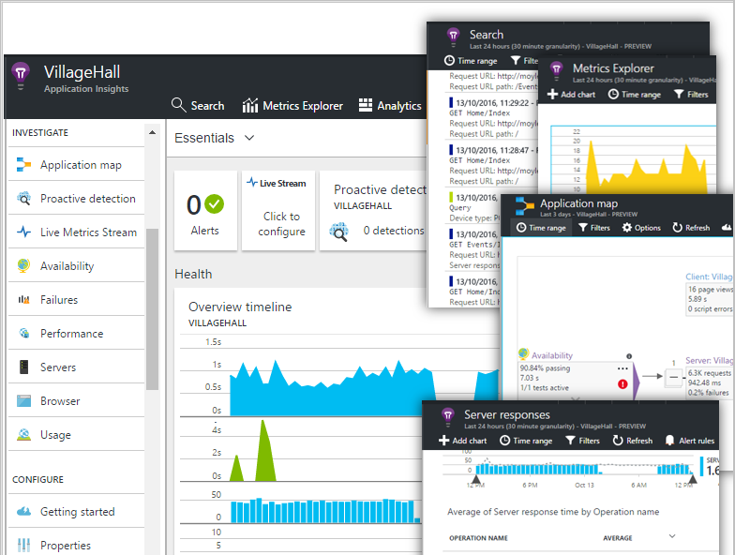
Dashboards and Metrics
Request rates
Dependency rates
Response times
Failure rates
CPU load
Network Traffic

Slide 13
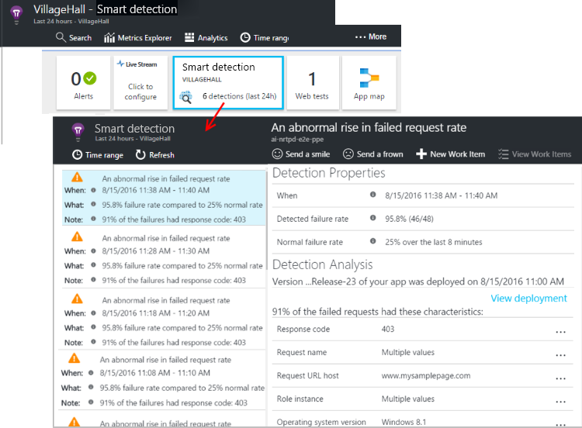
Smart detection
Automatic alerts based on your app
Triggers when outside the usual pattern.
Alerts on custom or standard metrics.

Slide 14
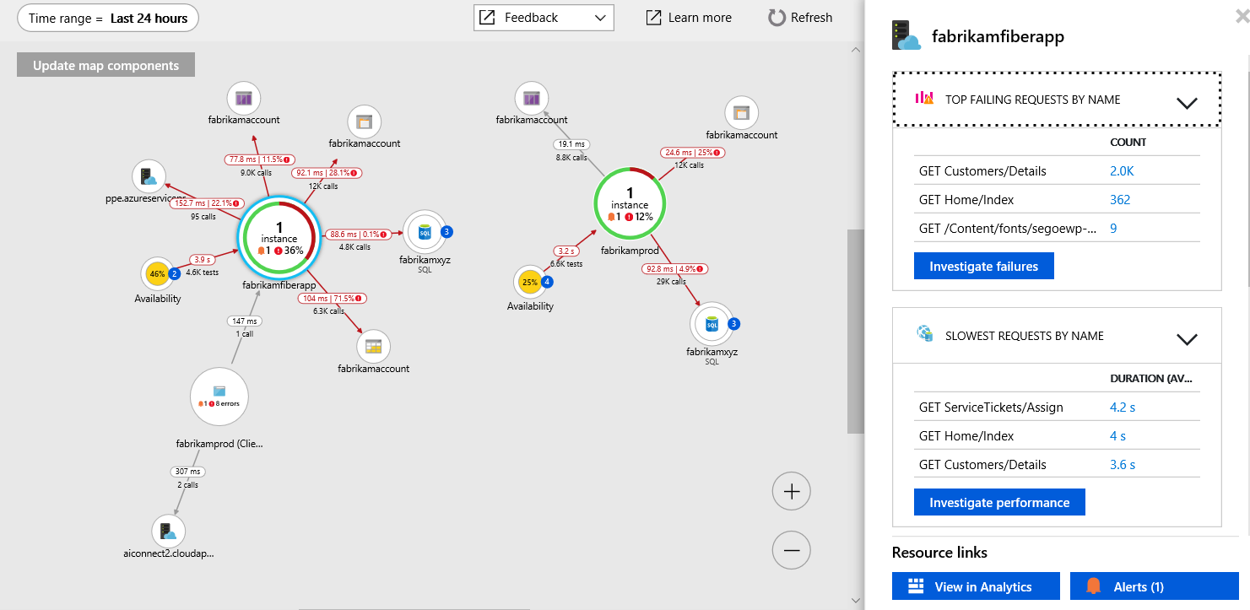
Application map
Each component
Key metrics
Alerts.

Slide 15
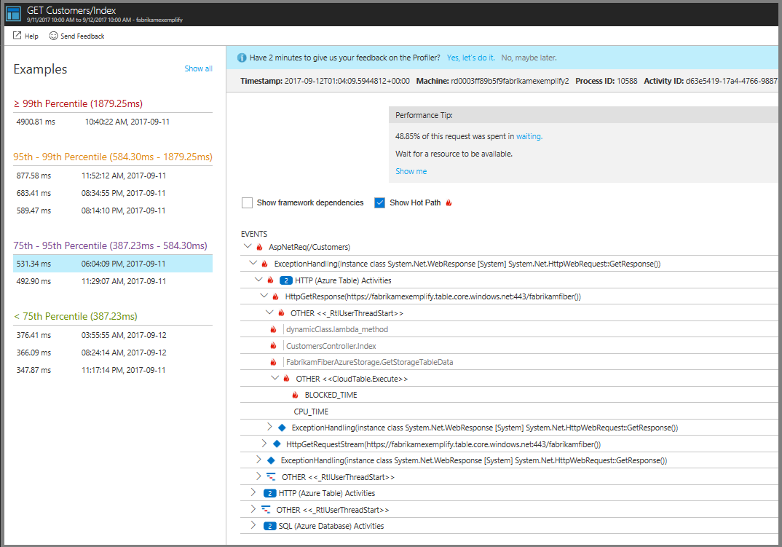
Profiler
Show Hot Path
Label
Elapsed
When
*Profiler runs randomly two times every hour and for a duration of two minutes each time it runs
Notes:
Show Hot Path: Opens the biggest leaf node, or at least something close. In most cases, this node is adjacent to a performance bottleneck.
Label: The name of the function or event. The tree displays a mix of code and events that occurred (like SQL and HTTP events). The top event represents the overall request duration.
Elapsed: The time interval between the start of the operation and the end of the operation.
When: The time when the function or event was running in relation to other functions.

Slide 16
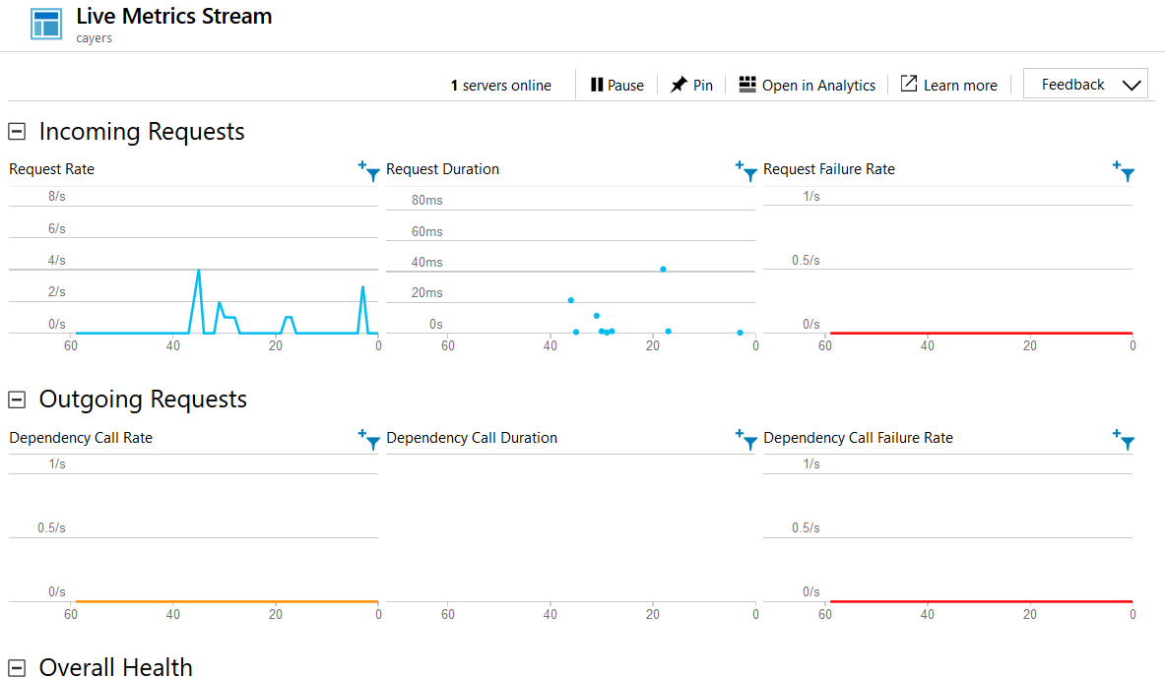
Live Metrics Stream
Monitor & Diagnose with 1-second latency
Filter to a specific Server
Watch the effect of test loads, and diagnose issues live
Notes:
Show Hot Path: Opens the biggest leaf node, or at least something close. In most cases, this node is adjacent to a performance bottleneck.
Label: The name of the function or event. The tree displays a mix of code and events that occurred (like SQL and HTTP events). The top event represents the overall request duration.
Elapsed: The time interval between the start of the operation and the end of the operation.
When: The time when the function or event was running in relation to other functions.

Slide 17
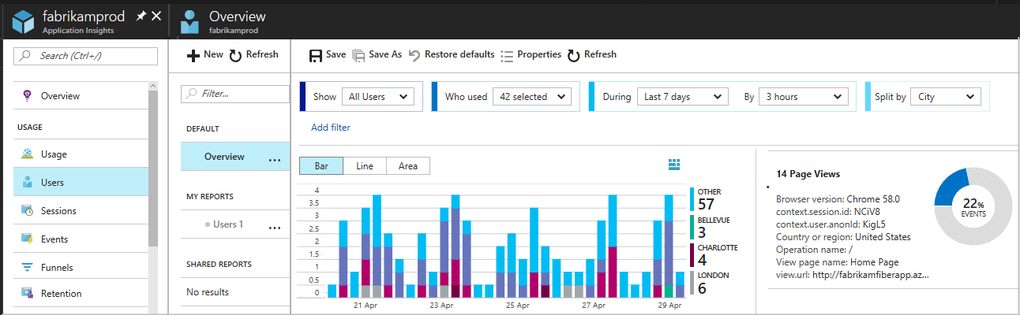
Usage
Notes:
Show Hot Path: Opens the biggest leaf node, or at least something close. In most cases, this node is adjacent to a performance bottleneck.
Label: The name of the function or event. The tree displays a mix of code and events that occurred (like SQL and HTTP events). The top event represents the overall request duration.
Elapsed: The time interval between the start of the operation and the end of the operation.
When: The time when the function or event was running in relation to other functions.

Slide 18
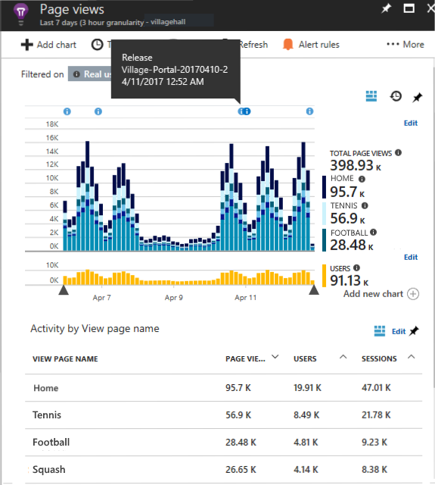
Page Views
Notes:
Show Hot Path: Opens the biggest leaf node, or at least something close. In most cases, this node is adjacent to a performance bottleneck.
Label: The name of the function or event. The tree displays a mix of code and events that occurred (like SQL and HTTP events). The top event represents the overall request duration.
Elapsed: The time interval between the start of the operation and the end of the operation.
When: The time when the function or event was running in relation to other functions.

Slide 19
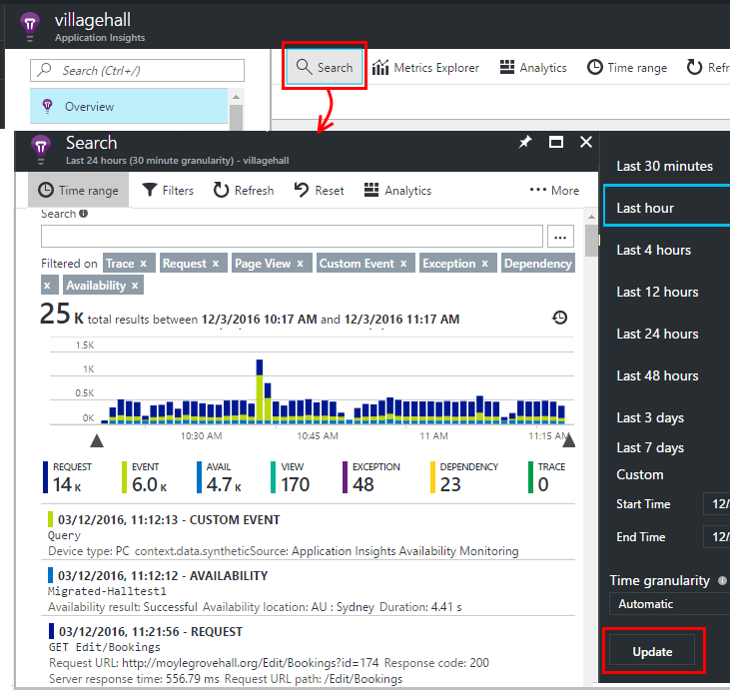
Search
Notes:
Show Hot Path: Opens the biggest leaf node, or at least something close. In most cases, this node is adjacent to a performance bottleneck.
Label: The name of the function or event. The tree displays a mix of code and events that occurred (like SQL and HTTP events). The top event represents the overall request duration.
Elapsed: The time interval between the start of the operation and the end of the operation.
When: The time when the function or event was running in relation to other functions.

Slide 20
Pricing
Data Ingestion | See Azure Log Analytics data ingestion rates
Data Retention | 90 days
Multi-step web tests ^{3, 4} | $10 per test per month
Ping web tests⁴ | Free
Notes:
Show Hot Path: Opens the biggest leaf node, or at least something close. In most cases, this node is adjacent to a performance bottleneck.
Label: The name of the function or event. The tree displays a mix of code and events that occurred (like SQL and HTTP events). The top event represents the overall request duration.
Elapsed: The time interval between the start of the operation and the end of the operation.
When: The time when the function or event was running in relation to other functions.

Slide 21
Pricing
Feature | Free Units Included | Price
Data Ingestion | 5 GB per month¹ | $2.30 GB per month
Data Retention | 31 days² | $0.10 per GB per month
Notes:
Show Hot Path: Opens the biggest leaf node, or at least something close. In most cases, this node is adjacent to a performance bottleneck.
Label: The name of the function or event. The tree displays a mix of code and events that occurred (like SQL and HTTP events). The top event represents the overall request duration.
Elapsed: The time interval between the start of the operation and the end of the operation.
When: The time when the function or event was running in relation to other functions.

Slide 22
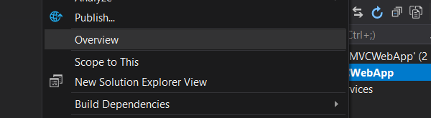
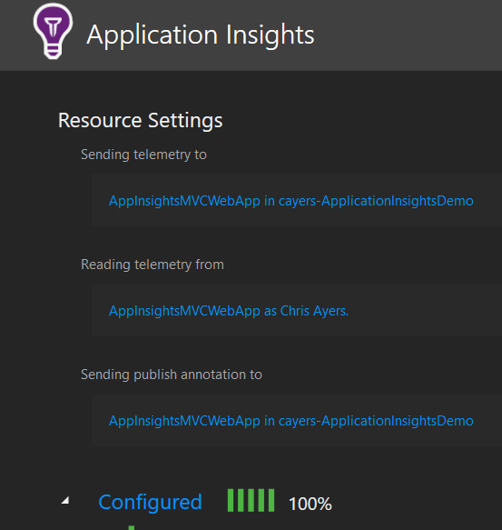
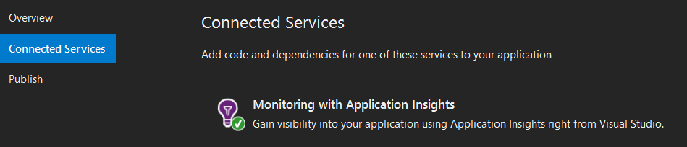
Azure Application Insights
Tooling

Slide 23
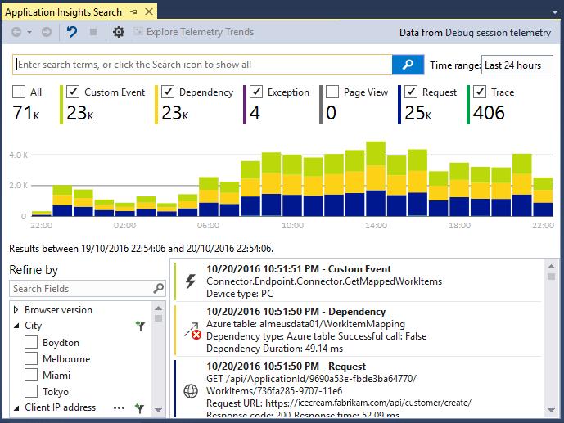
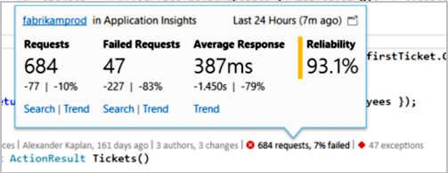
Azure Application Insights
Tooling – Code Lens

Slide 24

Azure Application Insights Demo

Slide 25
Visual Studio Demo

Slide 26
Visual Studio Code Demo

Slide 27

Questions

